Slide 1
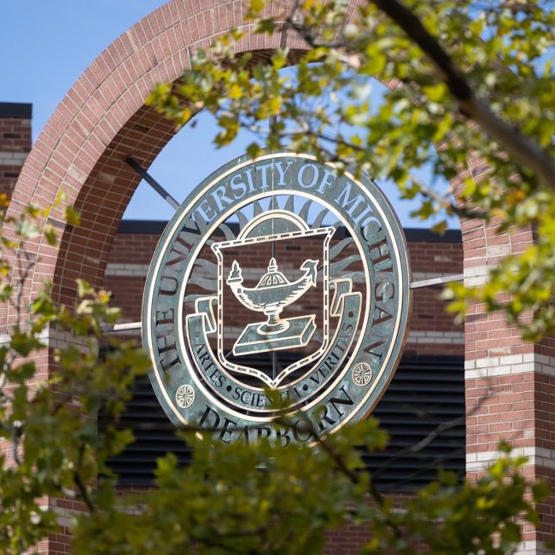
A Proposal for the Machine Learning Approach
Zaynab Mourtada, Soham Naik, Deniz Ackibas, Alan Raj
1/10/2025

Slide 2
Objective
Evaluate three relevant research papers.
Propose the best approach for implementing air-writing recognition with LED gloves.

Slide 3
Research Papers Overview
Paper #1: Trajectory-Based Air Writing Recognition
Paper #2: Air-Text: Air-Writing and Recognition System
Paper #3: Air-Writing Recognition Using CNN and LSTM

Slide 4
Research Paper #1 Key Takeaways
Setup & Data Collection: Depth sensors captured spatial trajectories.
Preprocessing:
Nearest Neighbor Normalization (better accuracy).
Root Point Normalization (ensures consistency).
Modeling:
LSTM: Best for digit recognition, excels with sequential data.
CNN: Focused on spatial features but less effective.
Findings: LSTM outperformed CNN for long-term dependencies.

Slide 5
Paper #1 - Relevance to Our Project
LSTM modeling approaches can be adapted for LED gloves.
Smoothing and sequential modeling align with our goals.
LSTM’s success with digit recognition informs our text inference design.

Slide 6
Research Paper #2 Key Takeaways
Modules:
Air-Writing: Tracks fingertip locations and creates binary images.
Text-Recognition: Uses TPS-ResNet-BiLSTM-Attn for text prediction.
Model: Combines TPS, ResNet, BiLSTM, and Attention for accurate recognition.

Slide 7
Paper #2 - Relevance to Our Project
Adapt fingertip tracking to LED brightness localization.
TPS-ResNet-BiLSTM-Attn offers a strong base for trajectory-to-text conversion.

Slide 8
Research Paper #3 Key Takeaways
Dynamic Models:
LSTM: Best for time-series data and sequential gestures.
BLSTM, CNN-LSTM, TCN: Effective but less accurate than LSTM.
Static Models:
CNN: Good for binary image-based data.
TCN-Static: Performed the worst.
Combined Model: Combining LSTM and CNN slightly reduced accuracy.

Slide 9
Paper #3 - Relevance to Our Project
LSTM is ideal for recognizing air-written digit sequences.
Reinforces the importance of dynamic models for efficient recognition.
Insights into combining spatial and sequential features can refine text conversion.

Slide 10
Proposed Approach
Preprocessing:
Nearest Neighbor Normalization for smoothing.
Modeling:
Trajectory Tracking: YOLO for LED localization.
Text Recognition: Combine LSTM for digit recognition and TPS-ResNet-BiLSTM-Attn for word inference.

Slide 11

Q & A THANK YOU

